Slide 1
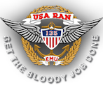
EXPERIMENTAL
MILITARY UNIT
The unit that should not have worked — but did
ROYAL AUSTRALIAN NAVY × UNITED STATES ARMY
SOUTH VIETNAM / 1967–1971
EMU
135th Assault Helicopter Company
Sources: Royal Australian Navy; Australian War Memorial; Huey Vets / 135th AHC

Slide 2
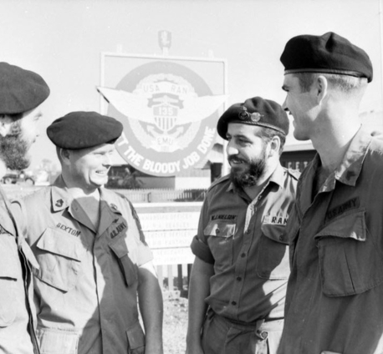
WHAT MADE EMU UNIQUE
02
One company. Two services. One cockpit.
The RAN Helicopter Flight Vietnam did not merely support the U.S. Army — it was fully integrated into the 135th Assault Helicopter Company.
ARCHIVE PHOTOGRAPH
NAVY21074
≈ 1/3
≈ 2/3
Royal Australian Navy personnel
United States Army personnel
The only integrated U.S.–Australian unit of the Vietnam War
Australian and American personnel at Bearcat beside the EMU emblem and motto, March 1970. Public domain.
CALL SIGNS
EMU / slick platoons
TAIPAN / gun platoon
AUSTRALIAN WAR MEMORIAL
Sources: navy.gov.au; hueyvets.com/135th-ahc; AWM collection NAVY21074

Slide 3
FORMATION
03
A pilot shortage created an experiment.
A request for people—not aircraft—set a joint combat unit in motion.
DEC 1966
JUL 1967
16–17 OCT
3 NOV 1967
JUN 1971
U.S. request
RANHFV formed
Vietnam arrival
First mission
RAN departs
Australia is asked for helicopter aircrew and maintainers.
Fleet Air Arm personnel prepare for air-mobile operations.
The first contingent joins the 135th at Vung Tau.
EMU begins operational flying in South Vietnam.
Four successive contingents complete the deployment.
1967
A company-sized force was assembled, trained, integrated and sent into combat in under a year.
Sources: Anzac Portal; Department of Veterans’ Affairs EMU memorial; navy.gov.au

Slide 4
COMMAND STRUCTURE
04
Operationally American; nationally Australian.
RAN personnel retained their service identity while flying inside the U.S. Army aviation chain.
U.S. ARMY AVIATION
SUPPORTED ON THE GROUND
1st Aviation Brigade
Army of the Republic of Vietnam
01
↓
GROUP
U.S. Army and Marine Corps
12th Aviation Group
02
↓
COMPANY
03
Australian Army / 1ATF
135th Assault Helicopter Company
↓
U.S. Navy SEAL Team One
EMBEDDED RAN ELEMENT
04
RAN Helicopter Flight Vietnam
The experiment worked because authority was clear in the air—even when uniforms were not the same.
Sources: Nepean Naval Museum; Huey Vets / 135th AHC; navy.gov.au

Slide 5
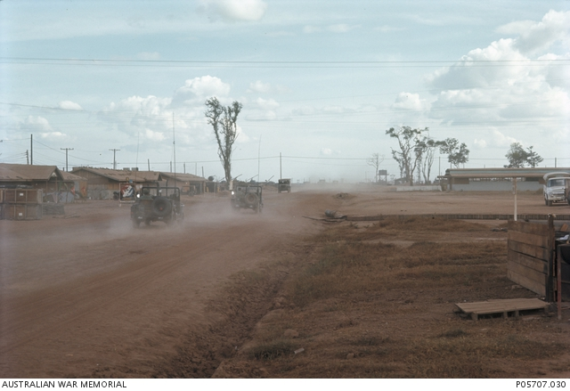
WHERE EMU OPERATED
05
Five bases carried the war south.
The company followed the fight from Phước Tuy into the Mekong Delta.
VŨNG TÀU
ARCHIVE PHOTOGRAPH
Arrival and first mission
III CORPS
P05707.030
BLACKHORSE
Phước Tuy • Saigon approaches • Long Khánh
Near Xuân Lộc • Dec 1967
BEARCAT
Northeast of Saigon • from Nov 1968
IV CORPS
ĐỒNG TÂM
Mekong Delta • Kiến Hòa • Vĩnh Bình • U Minh
Mekong Delta operations
Bearcat flight line, May 1969. The 135th AHC had moved here in November 1968.
DĨ AN
Later company base
AUSTRALIAN WAR MEMORIAL
Sources: AWM collection P05707.030; Huey Vets / 135th AHC; FAA Association “RAN HFV Story”

Slide 6
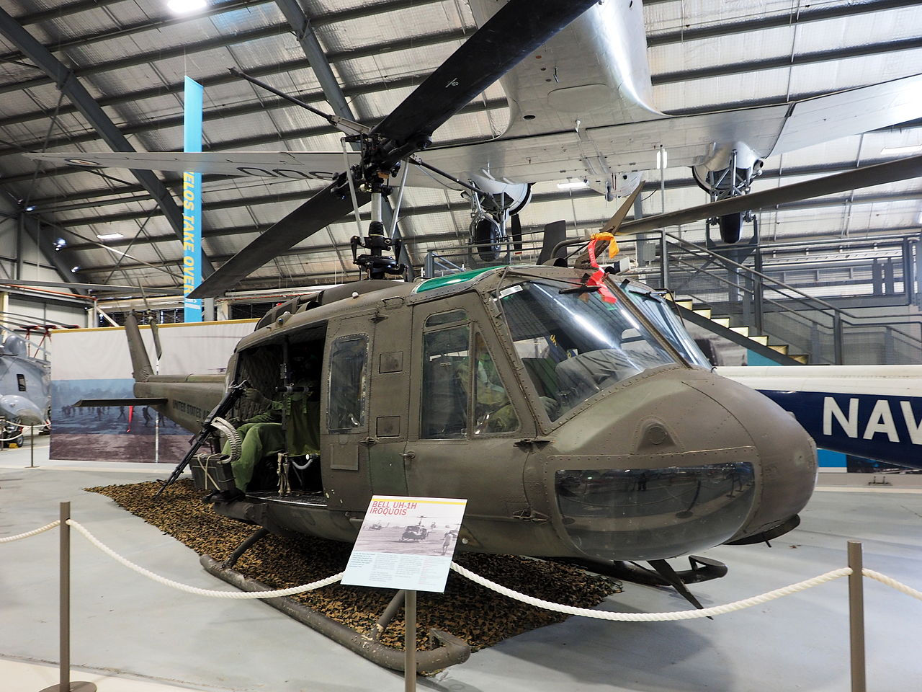
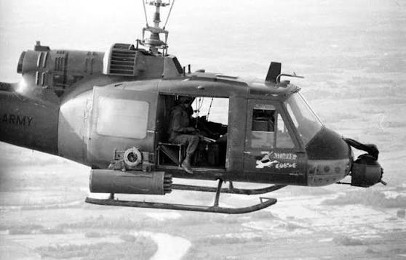
AIRCRAFT
06
The daily package paired lift with firepower.
Both roles used Bell UH-1 Iroquois “Hueys”—configured for different work.
H
C
UH-1C / GUNSHIP
UH-1H / SLICK
Troop transport • insertion • extraction • resupply • casualty evacuation
Armed escort • landing-zone suppression • fire support • hunter-killer cover
CALL SIGN EMU
CALL SIGN TAIPAN
10
4
+1
transports in a typical assault package
gunships in support
command element
Sources: FAA Association “RAN HFV Story”; Huey Vets / 135th AHC; navy.gov.au
Notes:
UH-1H / SLICK
Troop transport • insertion • extraction • resupply • casualty evacuation
CALL SIGN EMU
UH-1C / GUNSHIP
Armed escort • landing-zone suppression • fire support • hunter-killer cover
CALL SIGN TAIPAN

Slide 7
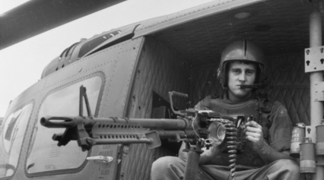
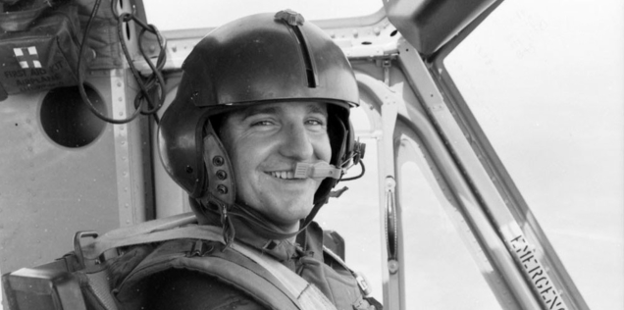
MISSIONS
07
Missions extended far beyond troop lift.
01
COMBAT ASSAULT
Insert and extract ARVN, U.S. and Australian troops under fire.
NAVY19683
ARCHIVE PHOTOGR APH
02
SUSTAIN
Move ammunition, supplies and equipment to dispersed forces.
RECOVER
Casualty evacuation and emergency extraction from contested areas.
RANHFV gunner Adrian Whiteman ready for action over the Mekong Delta, c. May 1969. Public domain.
03
AUSTRALIAN WAR MEMORIAL
04
HUNT
Dawn/dusk assaults and night hunter-killer sorties.
ARCHIVE PHOTOGRAPH
NAVY21102
05
ENABLE
Support U.S. Navy SEAL operations across the Mekong Delta.
Sub Lieutenant Eric Wile flying a 135th AHC mission over the Delta, March 1970. Public domain.
AUSTRALIAN WAR MEMORIAL
Sources: navy.gov.au; Huey Vets / 135th AHC; AWM NAVY19683 and NAVY21102
Notes:
RANHFV gunner Adrian Whiteman ready for action over the Mekong Delta, c. May 1969. Public domain.
Sub Lieutenant Eric Wile flying a 135th AHC mission over the Delta, March 1970. Public domain.

Slide 8
COMBAT REALITY
08
“Get the bloody job done” was operational, not theatrical.
SUB-LIEUTENANT ANDY PERRY / NIGHT MISSION
“We took our first hit at about 150 metres. It came in under the seat.”
8
HOURS FLOWN
BEFORE THE CALL
A bullet then came through the windshield. Wounded and flying a badly damaged UH-1, Perry completed three more landings before nursing the aircraft back to base.
The vignette captures the EMU method: continue the mission, protect the formation, bring the aircraft home if possible.
01
02
03
04
LEAD
HIT
RETURN
SURVIVE
AWM / Elizabeth Stewart
Nine-aircraft formation
Heavy machine-gun fire
Three more landings
Aircraft written off
Sources: Australian War Memorial, Elizabeth Stewart; Naval Historical Society, “These Gallant Aviators”
Notes:
Australian War Memorial, Elizabeth Stewart; Naval Historical Society, “These Gallant Aviators”
Under heavy .50 calibre machinegun fire the lead Huey, piloted by LEUT Marum, received several debilitating hits and was forced to return to Bearcat. SBLT Perry, who at the time was undertaking another sortie in an almost brand new Huey, volunteered to replace him as the lead helicopter in the assault. Without thought to his own safety or the arduous hours of flying he had already accomplished that day SBLT Perry offered his assistance.
Upon his first troop insertion SBLT Perry’s helicopter received multiple hits causing extensive damage. The helicopter was only made flyable again once repairs were completed stationary at the Landing Zone (LZ), an astonishing feat under incredibly onerous circumstances. On SBLT Perry’s third troop insertion the Huey was struck again, sustaining further damage to cockpit instruments and lighting, and deflecting shrapnel off the helicopter pedals which then embedded into SBLT Perry’s right foot. Despite the incapacity of the Huey, a loss of feeling in his foot and bleeding from his face SBLT Perry returned to the LZ twice more throughout the night, flying essentially blind.
‘By his courage, flying ability and cool commands of leadership, the flight of aircraft never faltered and the insertions were completed.’[6] SBLT Perry was mentioned in dispatches and was awarded the US Silver Star and the South Vietnamese Cross for his acts of gallantry in this operation, making him the most decorated RANHFV veteran. The nearly new helicopter he used that day was never to fly again.

Slide 9
RECORD AND LEGACY
09
A small contingent left a large record.
≈200
4
5
1
RAN personnel served across the deployment
year-long RAN contingents
RAN personnel killed in action
fully integrated U.S.–Australian unit
The experiment became a combat formation.
EMU combined different services, training systems and national chains of command inside one assault-helicopter company. Its distinction was not simply that Australians and Americans served together—it was that they shared the same aircraft, missions, risks and tactical authority.
Full URLs and image-rights notes are listed in the deck source ledger; statistics from navy.gov.au and DVA.
Notes:
The five RAN members who died serving with EMU were:
Lieutenant Commander Patrick John Vickers — killed on 22 February 1968 during a troop-movement operation.
Lieutenant Anthony Austin Casadio — killed on 21 August 1968 when his gunship was struck by an RPG.
Petty Officer Aircrewman O’Brian Cedric Ignatious Phillips — killed in the same crash as Casadio.
Acting Sub-Lieutenant Antony Jeffrey Huelin — killed on 3 January 1969 when his helicopter struck power lines during poor weather.
Leading Aircrewman Noel Ervin Shipp — killed on 31 May 1969 when his gunship was shot down at a landing zone.
These names and details are recorded by the Australian War Memorial Roll of Honour.

Slide 10
References
08
Bibliography
Hueyvets official website of EMU inc . https://www.hueyvets.com/
RAN Helicopter Flight Vietnam https://www.nepeannavalmuseum.org/post/ran-helicopter-flight-vietnam
The Machine Gunners of Company RAR and the 135th “Emus” https://www.faaaa.asn.au/wp-content/uploads/2024/05/2RAR-Gunners-v3-1-1.pdf
The service of the Royal Australian Navy Helicopter Flight https://www.navy.gov.au/about-navy/history/history-milestones/service-royal-australian-navy-helicopter-flight-vietnam
The EMU: getting the bloody job done https://www.awm.gov.au/wartime/51/stewart_emu_getting_job_done#:~:text=The%20Royal%20Australian%20Navy's%20Helicopter%20Flight%20Vietnam,Army%20and%20Marine%20Corps%20*%20Australian%20Army
These Gallant Aviators https://navyhistory.au/these-gallant-aviators/
Experimental Military Unit https://en.wikipedia.org/wiki/Experimental_Military_Unit
NAVY21074 • NAVY14714 • NAVY19683 • NAVY21102 • P05707.030
Photo accessions

